Slide 1
NOISE POLLUTION MONITORING

Slide 2
GROUP MEMBERS
BHUVANESWARAN. S(leader)
ARUNTHDEVI. M
DIVYA. M
DHIVYA. B
JAYASATHYA. R
KALAIYARASI. E

Slide 3
ABSTRACT
Noise pollution is unwanted sound, it needs to be controlled to make the workplace comfortable.
This chapter analyses noise mathematically and the effects of multiple sources are examined.
Two noises of exactly the same level can have a combined noise level that is 3 dB higher than the individual values.

Slide 4
INTRODUCTION
Noise pollution is considered to be any unwanted or disturbing sound.
That affects the health and well-being of humans and other organisms.
An IoT-based air and sound pollution monitoring system is implemented using a network of sensors, connectivity technologies, and data analytics platforms.
Air quality sensors are deployed in strategic locations to measure pollutant levels such as particulate matter, gases, and volatile organic compounds (VOCs).

Slide 5
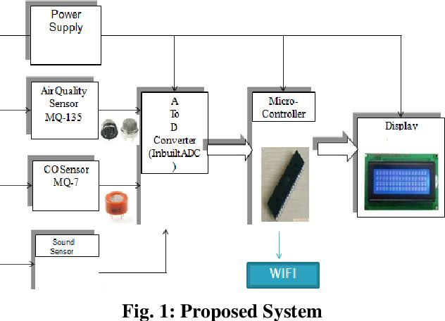
BLOCK DIAGRAM

Slide 6
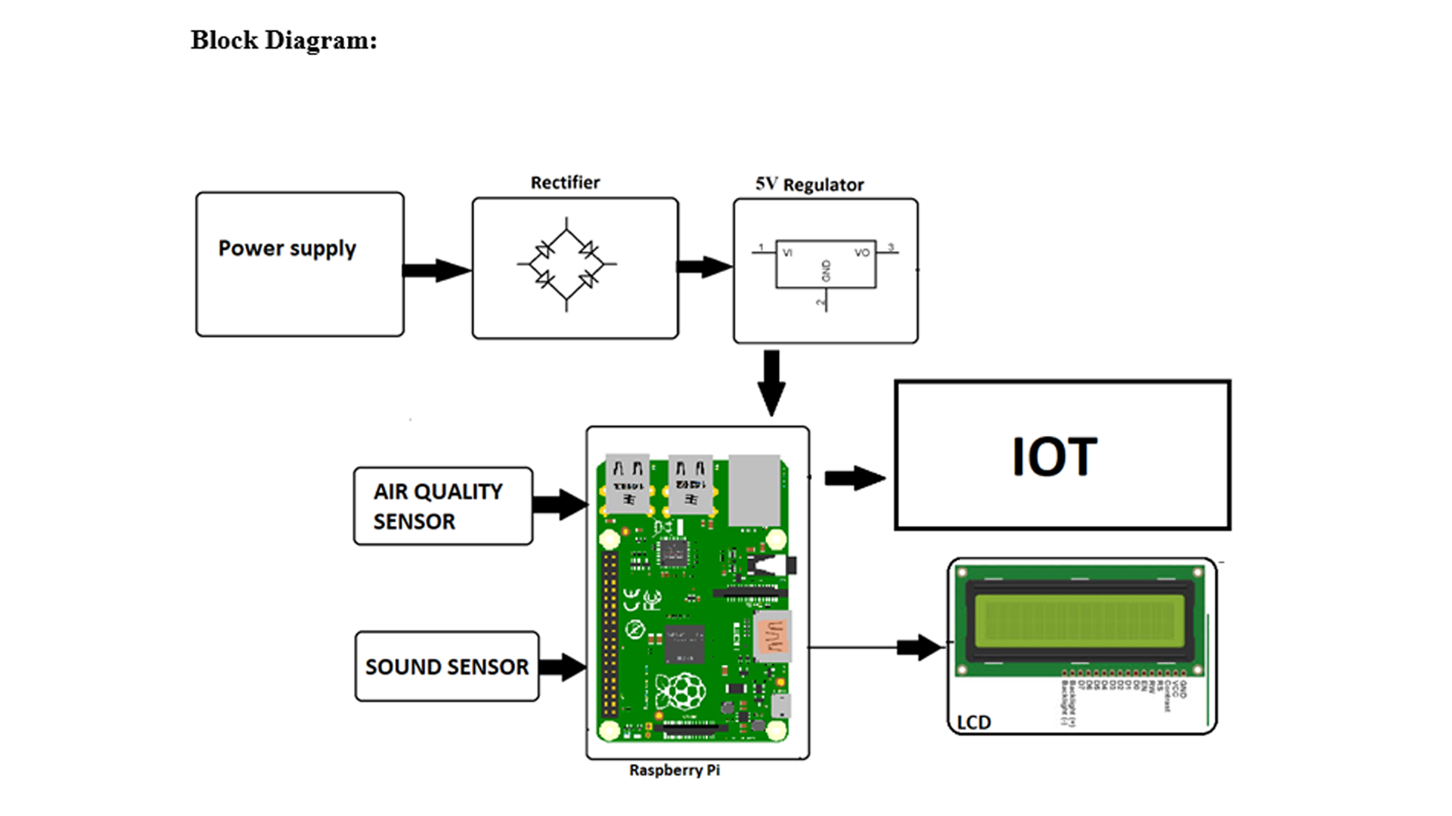
Circuit Diagram

Slide 7
Software
IMMI: This is noise modelling software which can simulate noise level at airports, traffic and inplant noises, etc

Slide 8
THANK YOU

